Slide 1
UMD iSchool Career Center Project
Information Challenge (IC)-22
Team 22038
Scott Mobarry
Salahdin Waji
Carmen Beleho

Slide 2
About this template
Background
The Problem
iSchool Careers needs creative ideas to improve the content of their newsletter, and the formatting of the wireframes.
Our Solution
By separating the audience, we decluttered the newsletter. This allowed room for additional improvements to be made on the format and wireframe.

Slide 3
Brainstorm
Empathize
Identified our target audience
Student
Alumni
Used our environment to identify the interests and needs of our audience
Notes:
Our Next step was to identify the target audience in order to empathize with them in our design. Undergraduate students, masters students, and Alumni were the 3 personas. Then we started focusing on their needs when coming to the newsletter

Slide 4
Brainstorm
Define
We defined the challenge by creating a problem statement:
“How can changing the format of the newsletter, effectively improve the user’s experience?”
Notes:
We wanted to keep the simple design, while also making it appealing to the reader. We started thinking of ways in which the user can get to the site, browse relevant information and be satisfied with the steps it takes to get there.

Slide 5
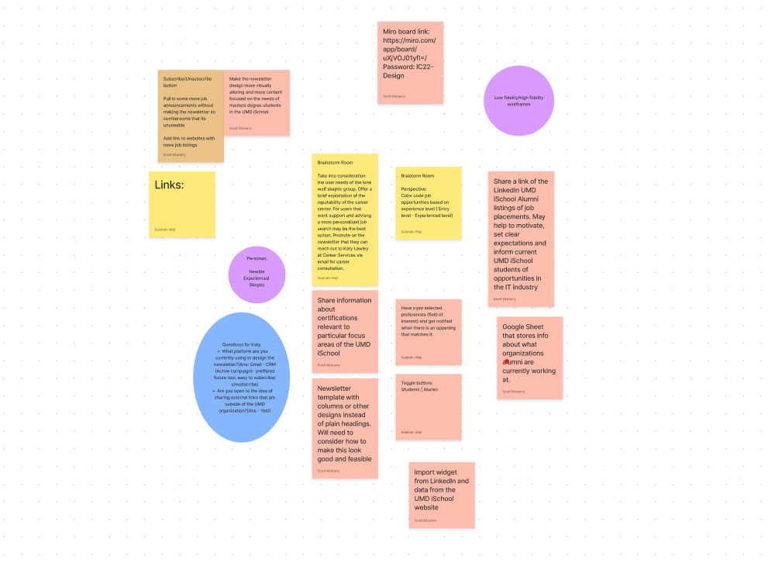
Brainstorm
Ideate
We brainstormed design solutions on figma
We identified the main personas
We started designing the wireframe to fit their needs
Notes:
We then started coming up with ideas that would make our design come to life.
We started considering the different kinds of visitors. The newbie (who is here for the first time and has very little idea of what to find, and where to find it)
The skeptic ( who like to rely on their own knowledge to find jobs, and need to know what the newsletter can do for them that they themselves can’t)
And The experienced (who is already in the job market and is looking for options)
Having that in mind,
We divided them into students, alumni

Slide 6
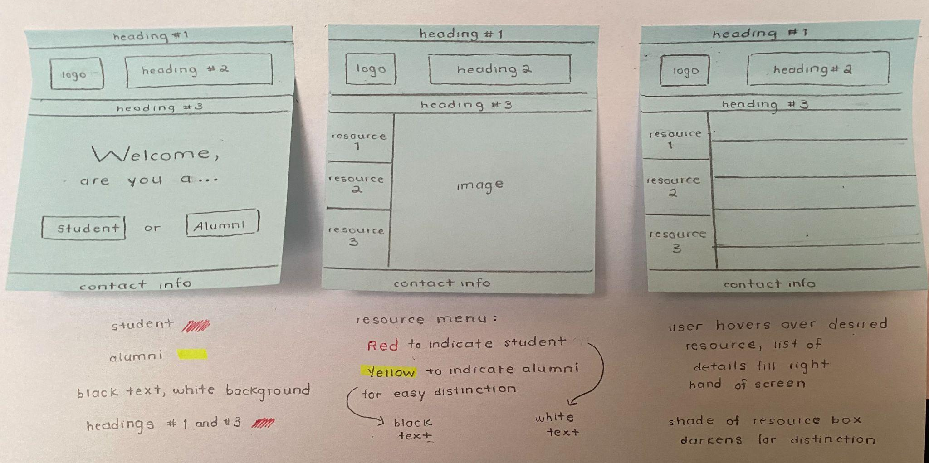
Brainstorm
Ideate
Notes:
We color coded the student side with red, and Alumni yellow in order for the reader to easily identify which mode they are on. And we created different resource menus to hold relevant information within them

Slide 7
Prototype
Prototype
We redesigned the wireframes
Desktop & Mobile view
We built a mockup site on Active Campaign
Notes:
We also developed Mobile view similar to the desktop view. Both views give the reader the ability to identify which mode they are in by just looking at the theme color
We then started thinking about testing that on Active Campaign

Slide 8
TEST
Test
Tested the design on Active Campaign
Created a scenario that captured a real life situation by exposing our prototypes to our mentor
Notes:
Once we have refined the prototypes on Figma, we wanted to test it on Active Campaign
We discussed our prototype with our mentor and made additional corrections

Slide 9
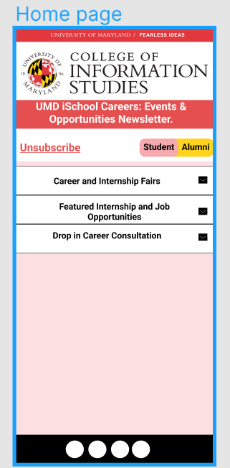
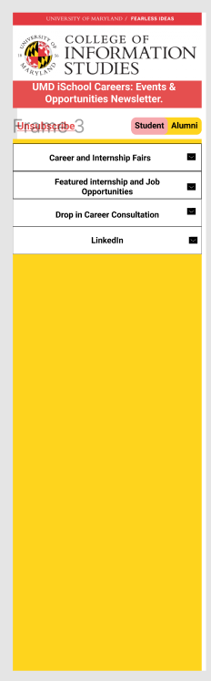
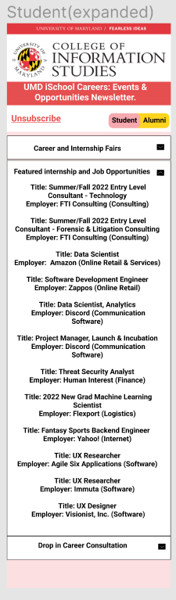
Wireframe
Mobile
Notes:
This is the final wireframe for the mobile view where a user can easily subscribe to or unsubscribe from the newsletter
Toggle between ‘Student’ mode and ‘Alumni’ mode
Use the drop down menus to access different sections including the capability to set up career consultation
And on the Alumni section (added capability to connect to linkedIn)

Slide 10
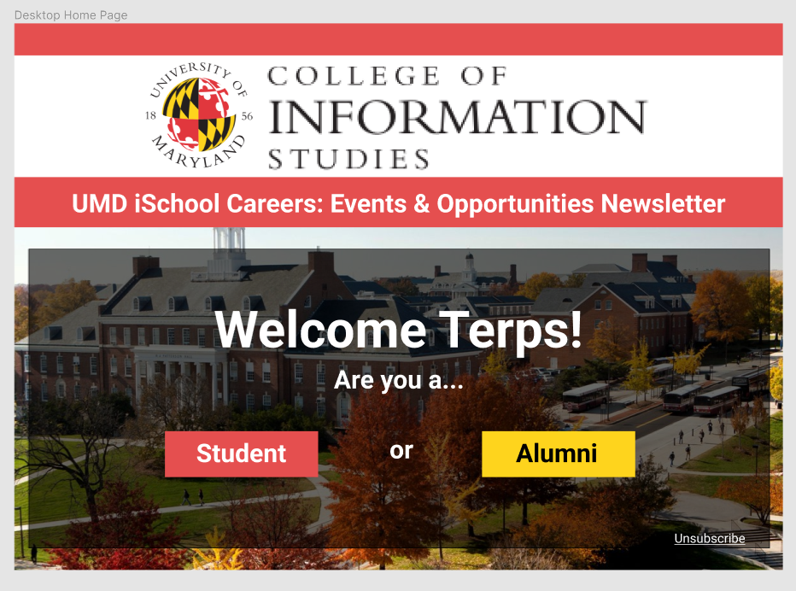
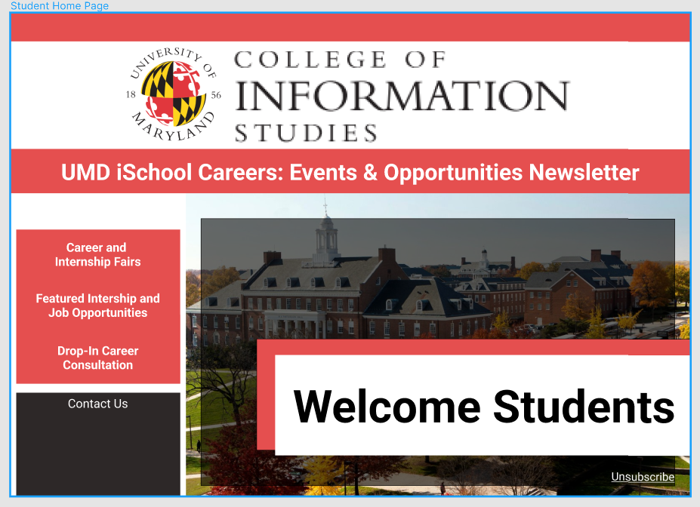
You can also split your content
Wireframe
Notes:
We used similar concept on the desktop version. Readers can go to their preferred section,
Then use the resource menu on the left side of the screen to go to their preferred section

Slide 11
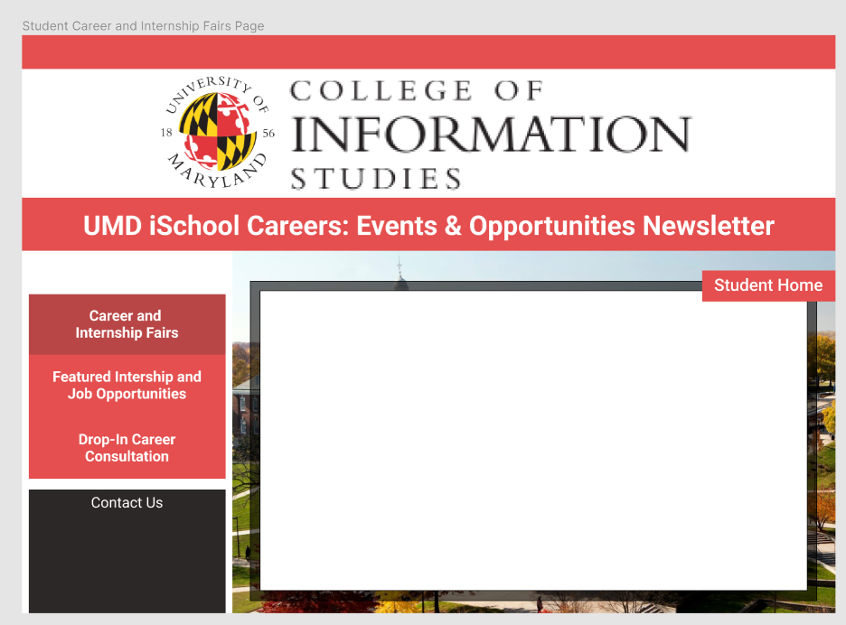
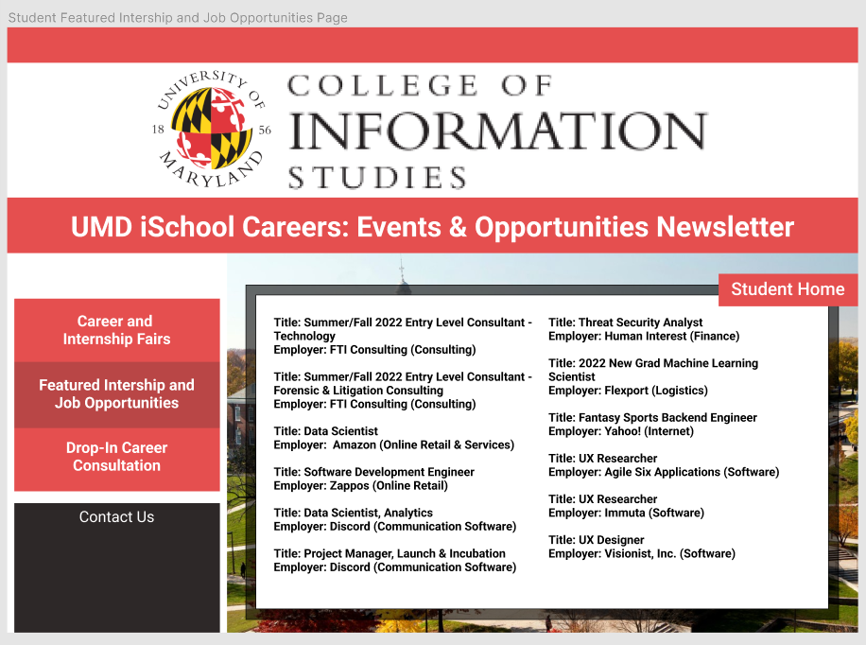
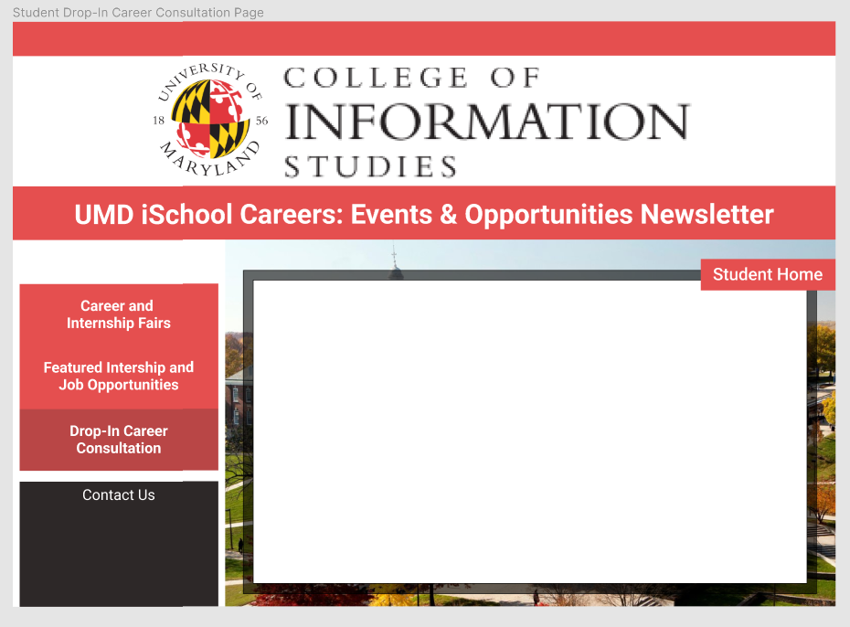
You can also split your content
Wireframe

Slide 12
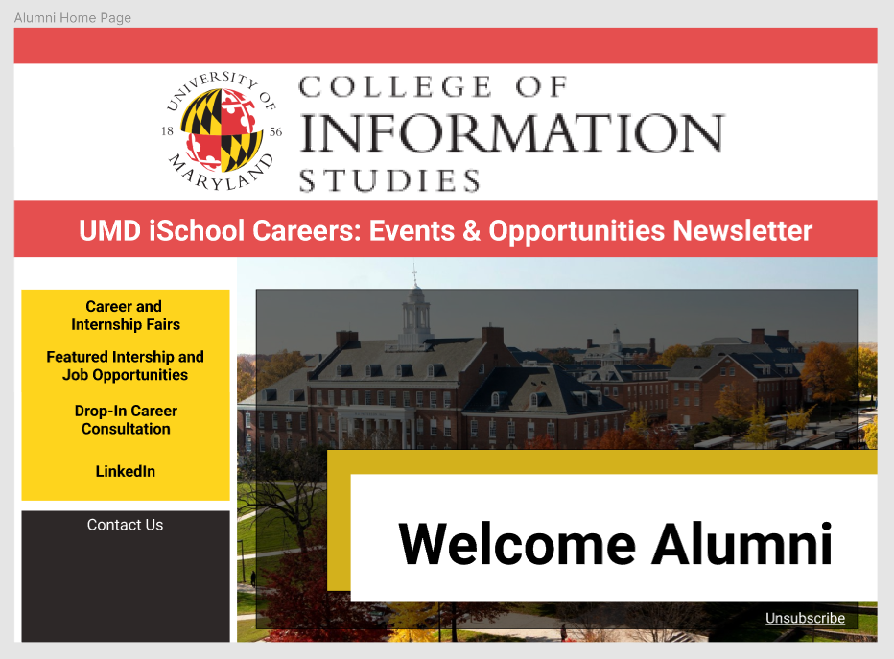
You can also split your content
Wireframe
Notes:
We kept the same color coding technique to differentiate between the two modes

Slide 13
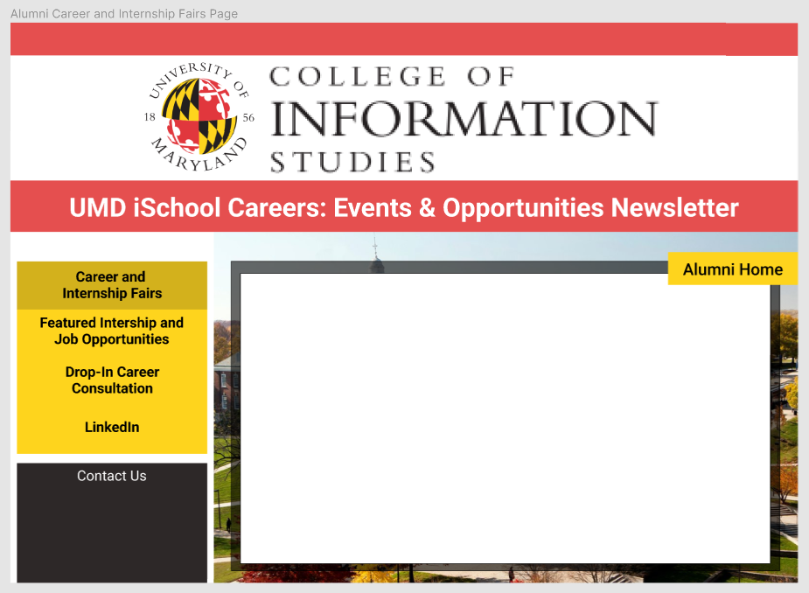
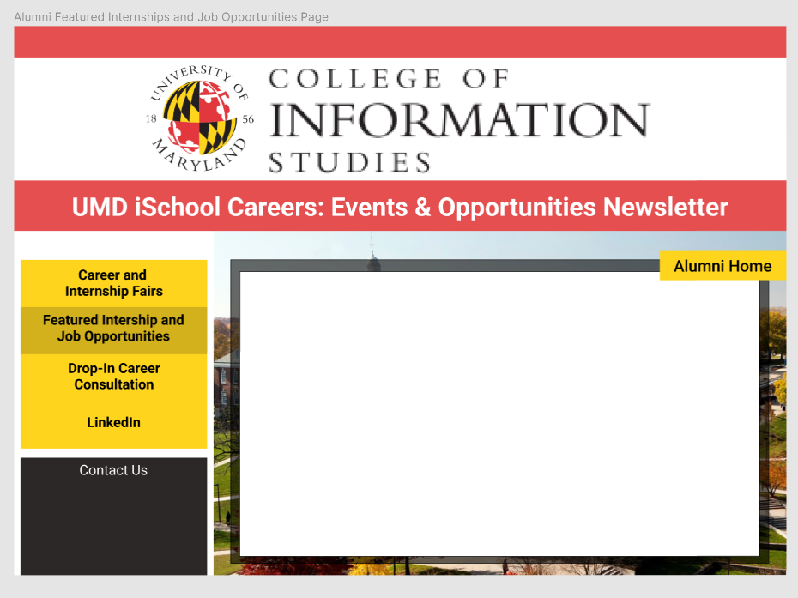
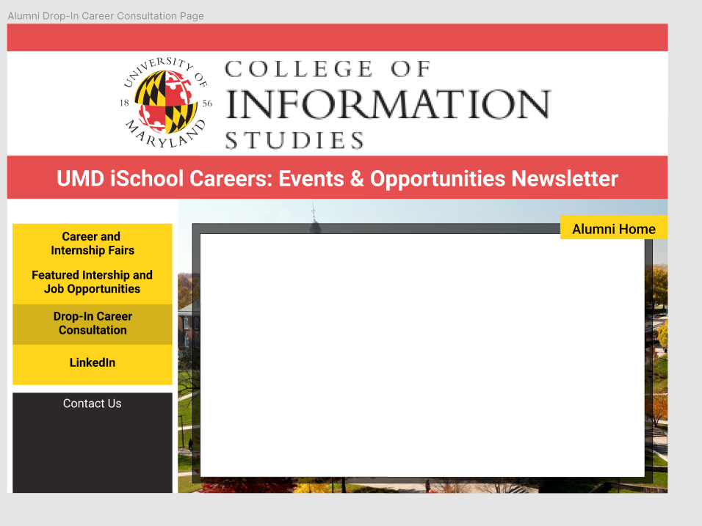
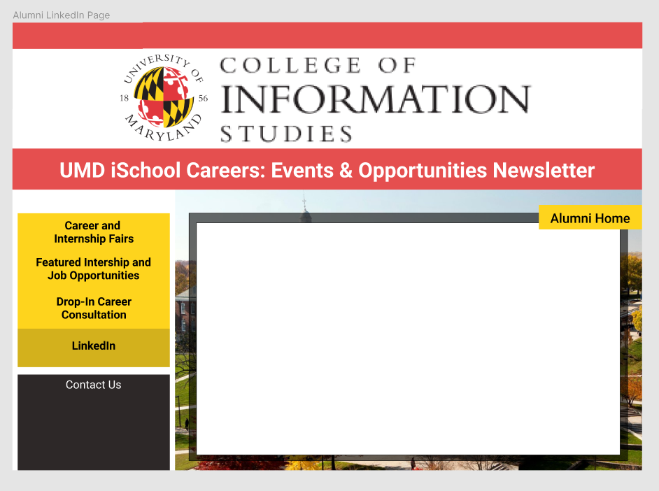
You can also split your content
Wireframe

Slide 14
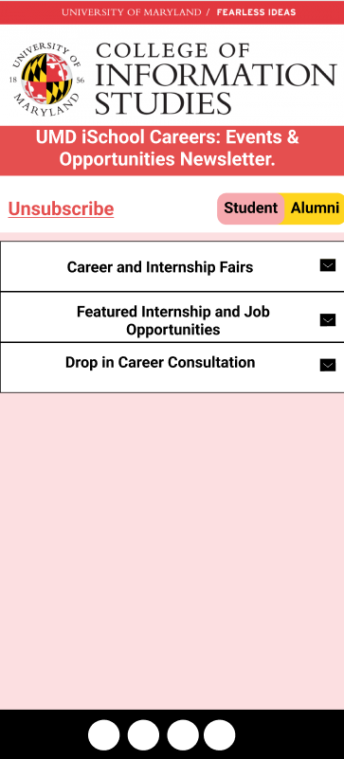
Mobile project
Mobile view has 3 main components
Unsubscribe
Student|Alumni
Drop down menu
Notes:
In summary, we included the 3 components for ease of use and readability

Slide 15
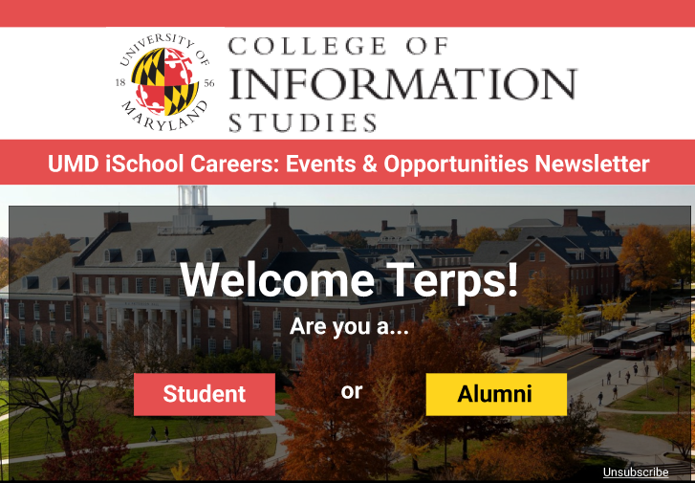

Slide 16
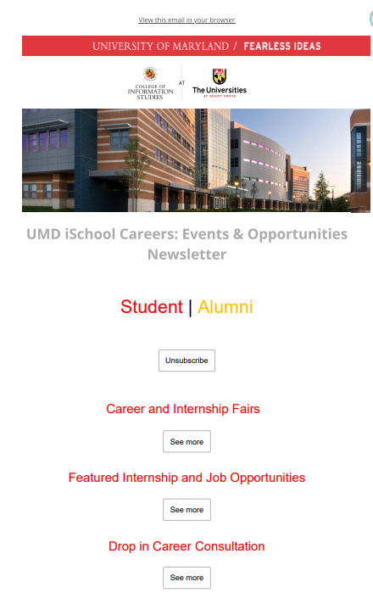
In two or three columns
Active Campaign
Notes:
This shows how it may look on an Active campaign site.

Slide 17
Thank you for listening.
ANY QUESTIONS?
Notes:
Thank you very much for listening to us
We are happy to answer any of your questions

